Slide 1


Case Study: Automating Duplicate Key Matching Using Power Query
FUNCTIONAL ANALYSIS

Slide 2
ABSTRACT
1. Background
On November 17, 2025, a recurring manual task was identified that consumed nearly a full working day. The task involved reconciling two Excel sheets containing duplicate keys and items. The manual process required filtering, matching, and copying data across sheets, which was both error-prone and time-intensive.
2. Problem Statement
Two Excel sheets contained duplicate keys and items.
The order of keys in the second sheet did not align with the first sheet.
The first sheet had incomplete data in its second column, requiring supplementation from the second sheet.
Manual reconciliation involved:
Matching keys across sheets.
Copying the second column values from the second sheet to align with the primary key column of the first sheet.
Estimated manual effort: ~8 hours (one full day).
Risks: Human error, inconsistent data entry, and lack of audit traceability.

Slide 3
Solution approach
To eliminate manual effort, Power Query was used to automate the reconciliation process.
Steps Taken:
1. Data Import
Both Excel sheets were loaded into Power Query.
2. Merge Query
A Left Outer Join was applied:
The first sheet served as the primary table.
The second sheet was merged based on the key column.
This ensured that all keys from the first sheet were retained, with corresponding matches from the second sheet.

Slide 4
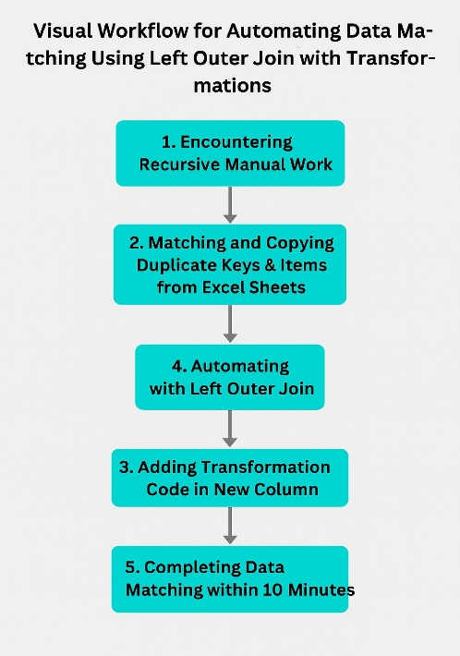
Solution approach
3. Transformation Logic
A new column was created to pull values from the second sheet’s second column.
Transformation code ensured proper alignment with the primary key column of the first sheet.
Duplicate handling was automated to prevent mismatches.
4. Output
A clean, reconciled dataset with aligned keys and complete second column values.
The process was reusable and scalable for future datasets.

Slide 5
outcomes
Time Efficiency:
Manual effort reduced from ~8 hours to ~10 minutes.
98% - time savings.
Quality Improvement:
Eliminated manual filtering and copying errors.
Ensured audit-proof, repeatable process.
Scalability:
The automated query can be reused for similar reconciliation tasks.
Adaptable for larger datasets without additional manual effort.

Slide 6
Knowledge transfer and documentation
This case study is documented for:
Future reference: To guide team members in handling similar reconciliation tasks.
Training purposes: Demonstrating the efficiency of Power Query for data automation.
Process improvement metrics: Highlighting measurable time savings and error reduction.
Lessons Learned
Manual reconciliation of duplicate keys is highly inefficient and prone to errors.
Power Query’s merge functionality with Left Outer Join provides a robust solution for aligning mismatched datasets.
Documenting automation processes ensures knowledge continuity and supports future audits.

Slide 7
conclusion
7. Conclusion
By leveraging Power Query, a tedious, daylong manual task was transformed into a 10-minute automated workflow. This not only saved significant time but also improved data accuracy and reliability. The solution demonstrates the value of automation in everyday data management tasks and sets a precedent for adopting similar approaches across other processes.

Slide 8
Visual workflow

